Slide 1

IFT222
Computer Architecture and Organization
Department of Computer and Information Sciences
Revision Class

Slide 2
Computer Architecture vs Computer Organization
Computer architecture refers to the functional design and logical structure of a computer system. It describes the following aspects of a computer: Instruction set, Data types, Addressing modes, Register organization. Computer Architecture also answers the question: “What does the computer do?”
Computer organization refers to the operational units and their interconnections that realize the architectural specifications. Organizational attributes include those hardware details transparent to the programmer, such as control signals; interfaces between the computer and peripherals; and the memory technology used. Thus, Computer Organization answers the question: “How does the computer do it?

Slide 3
Components of Computer Arch. & Computer Organization
Computer Architecture
  Instruction Set Architecture
  Data types and representation
  Instruction set and format
  Addressing Modes
  Register set
  System Design – Von Neumann and Harvard Architectures
Computer Organization
  Control unit
  ALU unit
  Memory organization
  Input/Output Systems
  System Buses and Interconnections
  Pipelling and Parallelism

Slide 4
Data Representation
Representation of Signed and Unsigned Numbers
Unsigned Numbers
Signed Numbers
  Sign – Magnitude representation
  1’s complement representation – end-around carry
  2’s complement representation
Other Representations
  Floating Point numbers
  Graphics and objects

Slide 5

Data Representation - Example
A spacecraft telemetry system uses a 16-bit processor to transmit environmental measurements. The following values are to be stored
  Temperature = -182;
  Pressure = 487;
  Altitude = -1023.
  The processor uses 2's complement representation for signed integers.
i) Determine the range of values representable in a 16-bit two's complement system.
Indicate whether the given numbers fall within the range of value
ii) Represent each value in: Binary and Hexadecimal
iii) Demonstrate how the processor uses two’s complement to compute (−182) + 487

Slide 6
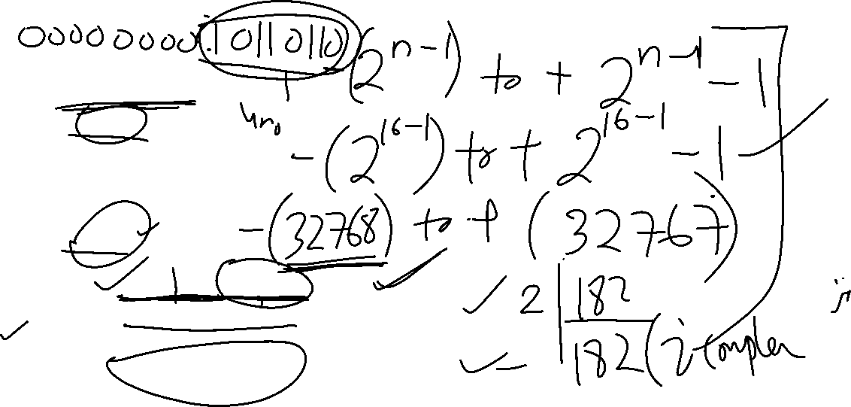
Data Representation - Example
(i) Range
For a 16-bit two's complement system,
Range = −2¹⁵ to 2¹⁵−1
= −32768 to 32767
All three values fall within the range.
(ii) Representations
Temperature = –182
182
Binary (16 bits): 0000000010110110 (+182)
Invert: 1111111101001001 (1’s complement)
Add 1
Binary Value: 1111111101001010 (2’s complement)
Hex: FF4A

Slide 7
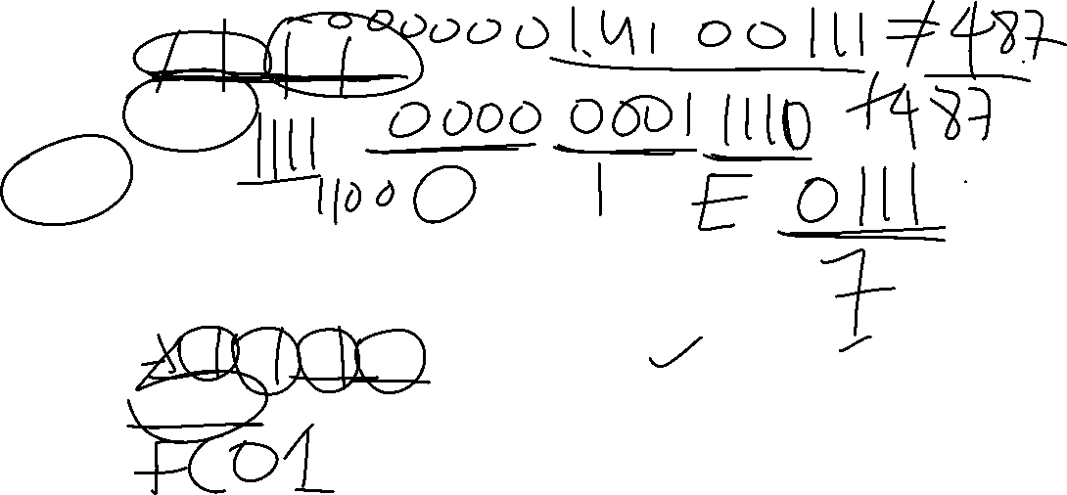
Data Representation - Example
Pressure = 487
Binary: 0000000111100111
Hex: 01E7
Altitude = –1023
1023
Binary: 0000001111111111 (+1023)
Invert: 1111110000000000 (1’s complement)
Add
Binary 11111110000000001 (2’s complement)
Hex: FC01

Slide 8
Data Representation - Example
(iii) Binary Addition
-182 = 1111111101001010 (2’s complement)
487 = 0000000111100111
Addition
1111111101001010
0000000111100111
------------------------
0000000100110001
Result: 305

Slide 9
Instruction Types -1
Within Instruction Set Architecture (ISA), types of instructions define the various operations a processor can perform on data.
These instructions determine how a program:
  Moves data
  Performs computations
  Makes decisions
  Interacts with memory and I/O devices

Slide 10


Instruction Types - 2
Load/Store Instructions
  Load/store operations are those which move data between a register in the processor and a memory location (or another register).
  Examples of load/store instructions in the MC68009 processor are LDA, STA, LDB, STB, LDD, STD, and so forth.
Arithmetic/Logic Instructions
  Arithmetic/logic operations provide the primary data-processing capabilities of the computer. The minimum arithmetic operations required are those of addition and subtraction. All processors, implement the basic logic operations of AND, OR, and exclusive-OR on a bit-by-bit basis between two operands.
  MC6809 are ADDB, SUBA, SUBD, ANDA, and EORA (exclusive-OR). Each of these requires one operand to be in an accumulator

Slide 11
Instruction Types - 3
Test/Branch Instructions
  Test/branch operations provide the decision-making capabilities in computer programs. The test is often performed on the result of some prior arithmetic/logic operation.
  Examples of test/branch instructions are BCC (branch if carry is cleared), BEQ (branch if equal to 0), BMI (branch if minus), and BRA (branch always).

Slide 12
Types of Instructions - Test/Branch Instructions
Depending upon the result, the processor may or may not branch to a remote location for the next instruction.
Examples of test/branch instructions are BCC (branch if carry is cleared), BEQ (branch if equal to 0), BMI (branch if minus), and BRA (branch always).

Slide 13
Instruction Format
An instruction is usually made up of a combination of an operation code and some way of specifying an operand, most commonly by its location or address in memory.
Instruction Format is the layout of bits in an instruction
An instruction is divided into Opcode (function), operand(s) (implicit or explicit) and addressing mode.
Instructions typically have 0,1,2 or 3 operands
There is usually more than one instruction format in an instruction set

Slide 14
General Structure of an Instruction
The format of an instruction is usually depicted in a rectangular box symbolizing the bits of the instruction as they appear in memory words or in a control register.
The bits of the instruction are divided into groups called fields. The most common fields found in instruction formats are:
Opcode
Mode
Address or Operand

Slide 15
Instruction Formats - Example
Use a Zero, One, Two and Three address instruction formats to write a Pentium 4 assembly language program segment for the expression below. X = ((A * B) +C/D)/(F*G+J*K)
Zero address | One address | Two address | Three address
PUSH A PUSH B MUL PUSH C PUSH D DIV ADD PUSH F PUSH G MUL PUSH J PUSH K MUL ADD DIV POP X | LOAD F MUL G STORE T LOAD J MUL K ADD T STORE T LOAD A MUL B STORE R LOAD C DIV D ADD R DIV T STORE X | MOV R1, A MUL R1, B MOV R2, C DIV R2, D ADD R1, R2 MOV R3, F MUL R3, G MOV R2, J MUL R2, K ADD R2, R3 DIV R1, R2 MOV X, R1 | MUL R1, A, B DIV R2, C, D ADD R1, R1, R2 MUL R2, F, G MUL R3, J, K ADD R2, R2, R3 DIV X, R2, R3

Slide 16
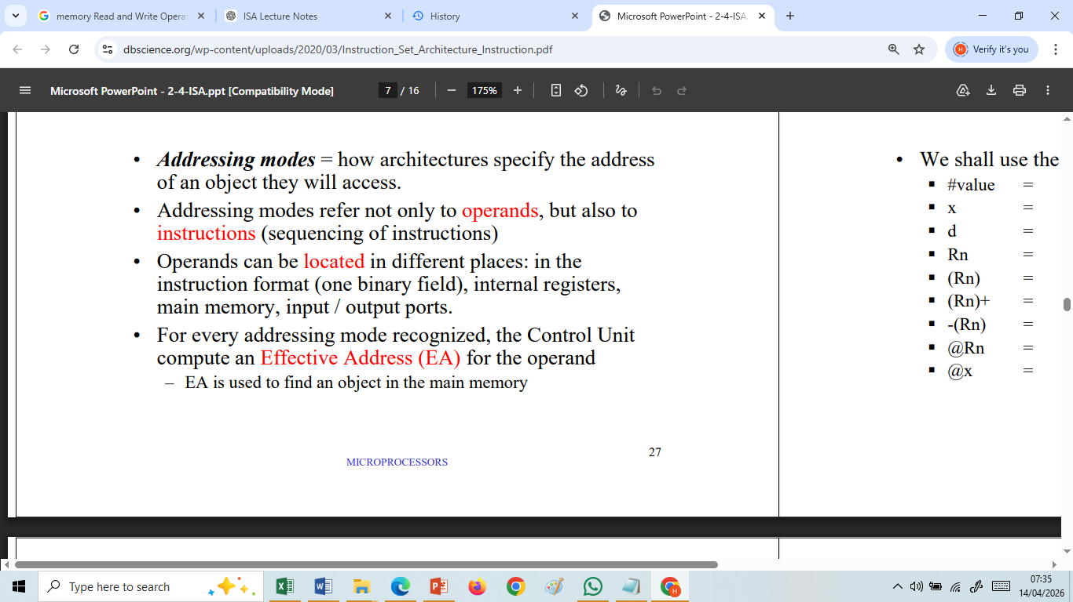
Addressing Modes

Slide 17
Example on Addressing Mode
A processor contains the following information: PC = 7000; R1 = 1500;
Memory Contents
Address Value
7000 1200
1200 4500
1500 6000
3200 8100
4500 999
6000 200
8100 400

Slide 18
Example on Addressing Mode
Assume an instruction contains address field 1200.
Determine the Effective Address (EA) and operand for the following addressing modes:
i) Immediate addressing mode
ii) Direct addressing mode
iii) Indirect addressing mode
iv) Register addressing mode
v) Register Indirect (R1) addressing mode
vi) Relative addressing mode

Slide 19
Addressing Mode – Solution – slide 1
i) Immediate
Operand = 1200
EA not required.
ii) Direct
EA = 1200
Operand = content of Memory [1200] = 4500
iii) Indirect
EA = content of Memory [1200] = 4500
Operand = content of Memory [4500] = 999
iv) Register
Suppose operand stored in R1.
Operand = 1500

Slide 20
Addressing Mode – Solution – slide 2
v) Register Indirect
EA = R1 = 1500
Operand = content of Memory [1500] = 6000
vi) Relative
EA = 7000 + 1200 = 8200
Operand = content of Memory [8200] = which is Not specified or Unknown

Slide 21
Example1 on Pipelining
A non-pipelined processor requires 60 ns per instruction.
The processor is redesigned into a 6-stage pipeline with a cycle time of 12 ns.
Calculate:
a. Time required for 50 instructions without pipelining
b. Time required for 50 instructions with pipelining
c. Speedup obtained

Slide 22
Pipelining - Solution (slide- 1)
Given:
Non-pipelined instruction time = 60 ns/instruction
Pipeline stages = 6
Pipeline cycle time = 12 ns
Number of instructions = 50

Slide 23
Pipelining - Solution (slide- 2)
(a) Time Required for 50 Instructions Without Pipelining
In a non-pipelined processor, each instruction must complete before the next one begins.
T_{non−pipeline}=n × t_{instruction}
Where:
n = 50
T_{instruction} = 60 ns
T_{non−pipeline}= 50 × 60
= 3000 ns or 3.0μs​

Slide 24
Pipelining - Solution (slide- 3)
(b) Time Required for 50 Instructions With Pipelining
Step 1: Determine Pipeline Latency
A 6-stage pipeline requires 6 clock cycles for the first instruction to complete.
Pipeline cycle time:
t_{c} = 12 ns
Time for first instruction:
6 × 12 =72 ns

Slide 25
Pipelining - Solution (slide- 4)
Step 2: Remaining Instructions
After the pipeline is filled, one instruction completes every cycle.
Remaining instructions:
50 - 1 = 49
Additional time:
49 × 12 = 588ns
Step 3: Total Pipeline Time
Using the general formula:
T_{pipeline} ​= (k+n−1)t_{c} ​

Slide 26
Pipelining - Solution (slide- 5)
where
K = 6 stages
n = 50 instructions
t_{c} = 12 ns
Tpipeline = (6+50−1)(12)
= 55 × 12
= 660 ns or 0.66 μs​ ​

Slide 27
Pipelining - Solution (slide- 6)
(c) Speedup Obtained
Speedup is defined as
Speedup = T_{non−pipeline}/T_{pipeline}
Substituting the values:
Speedup = 3000/660
=4.545
≈4.55​

Slide 28
Example 2 - Pipelining
Consider a pipeline having 4 phases with duration 60, 50, 90 and 80 ns. Given latch delay is 10 ns.
Calculate-
Pipeline cycle time
Non-pipeline execution time
Speed up ratio
Pipeline time for 500 tasks
Sequential time for 500 tasks

Slide 29
Pipelining – Solution (slide 1)
Given-
Four stage pipeline is used
Delay of stages = 60, 50, 90 and 80 ns
Latch delay or delay due to each register = 10 ns
1. Pipeline Cycle Time-
Cycle time
= Maximum delay due to any stage + Delay due to its register
= Max {60, 50, 90, 80} + 10 ns
= 90 ns + 10 ns
= 100 ns

Slide 30
Pipelining – Solution (slide 2)
2- Non-Pipeline Execution Time-
Non-pipeline execution time for one instruction
= 60 ns + 50 ns + 90 ns + 80 ns
= 280 ns
3 - Speed Up Ratio-
Speed up
= Non-pipeline execution time / Pipeline execution time
= 280 ns / Cycle time
= 280 ns / 100 ns
= 2.8

Slide 31
Pipelining – Solution (slide 3)
4 - Pipeline Time For 500 Tasks-
Pipeline time for 500 tasks
= Time taken for 1st task + Time taken for remaining 499 tasks
= 1 x 4 clock cycles + 499 x 1 clock cycle
= 4 x cycle time + 499 x cycle time
= 4 x 100 ns + 499 x 100 ns
= 400 ns + 49900 ns
= 50,300 ns
5- Sequential Time For 500 Tasks-
Non-pipeline time for 500 tasks
= 500 x Time taken for one task
    = 500 x 280 ns
    = 140,000 ns

Slide 32
Pipelining Hazards
Hazards reduce the performance from the ideal speedup gained by pipelines:
Structural hazard: Resource conflict.
Hardware cannot support all possible combinations of instructions in simultaneous overlapped execution.
Data hazard:
When an instruction depends on the results of the previous instruction.
Control hazard:
Due to branches and other instructions that affect the PC.

Slide 33
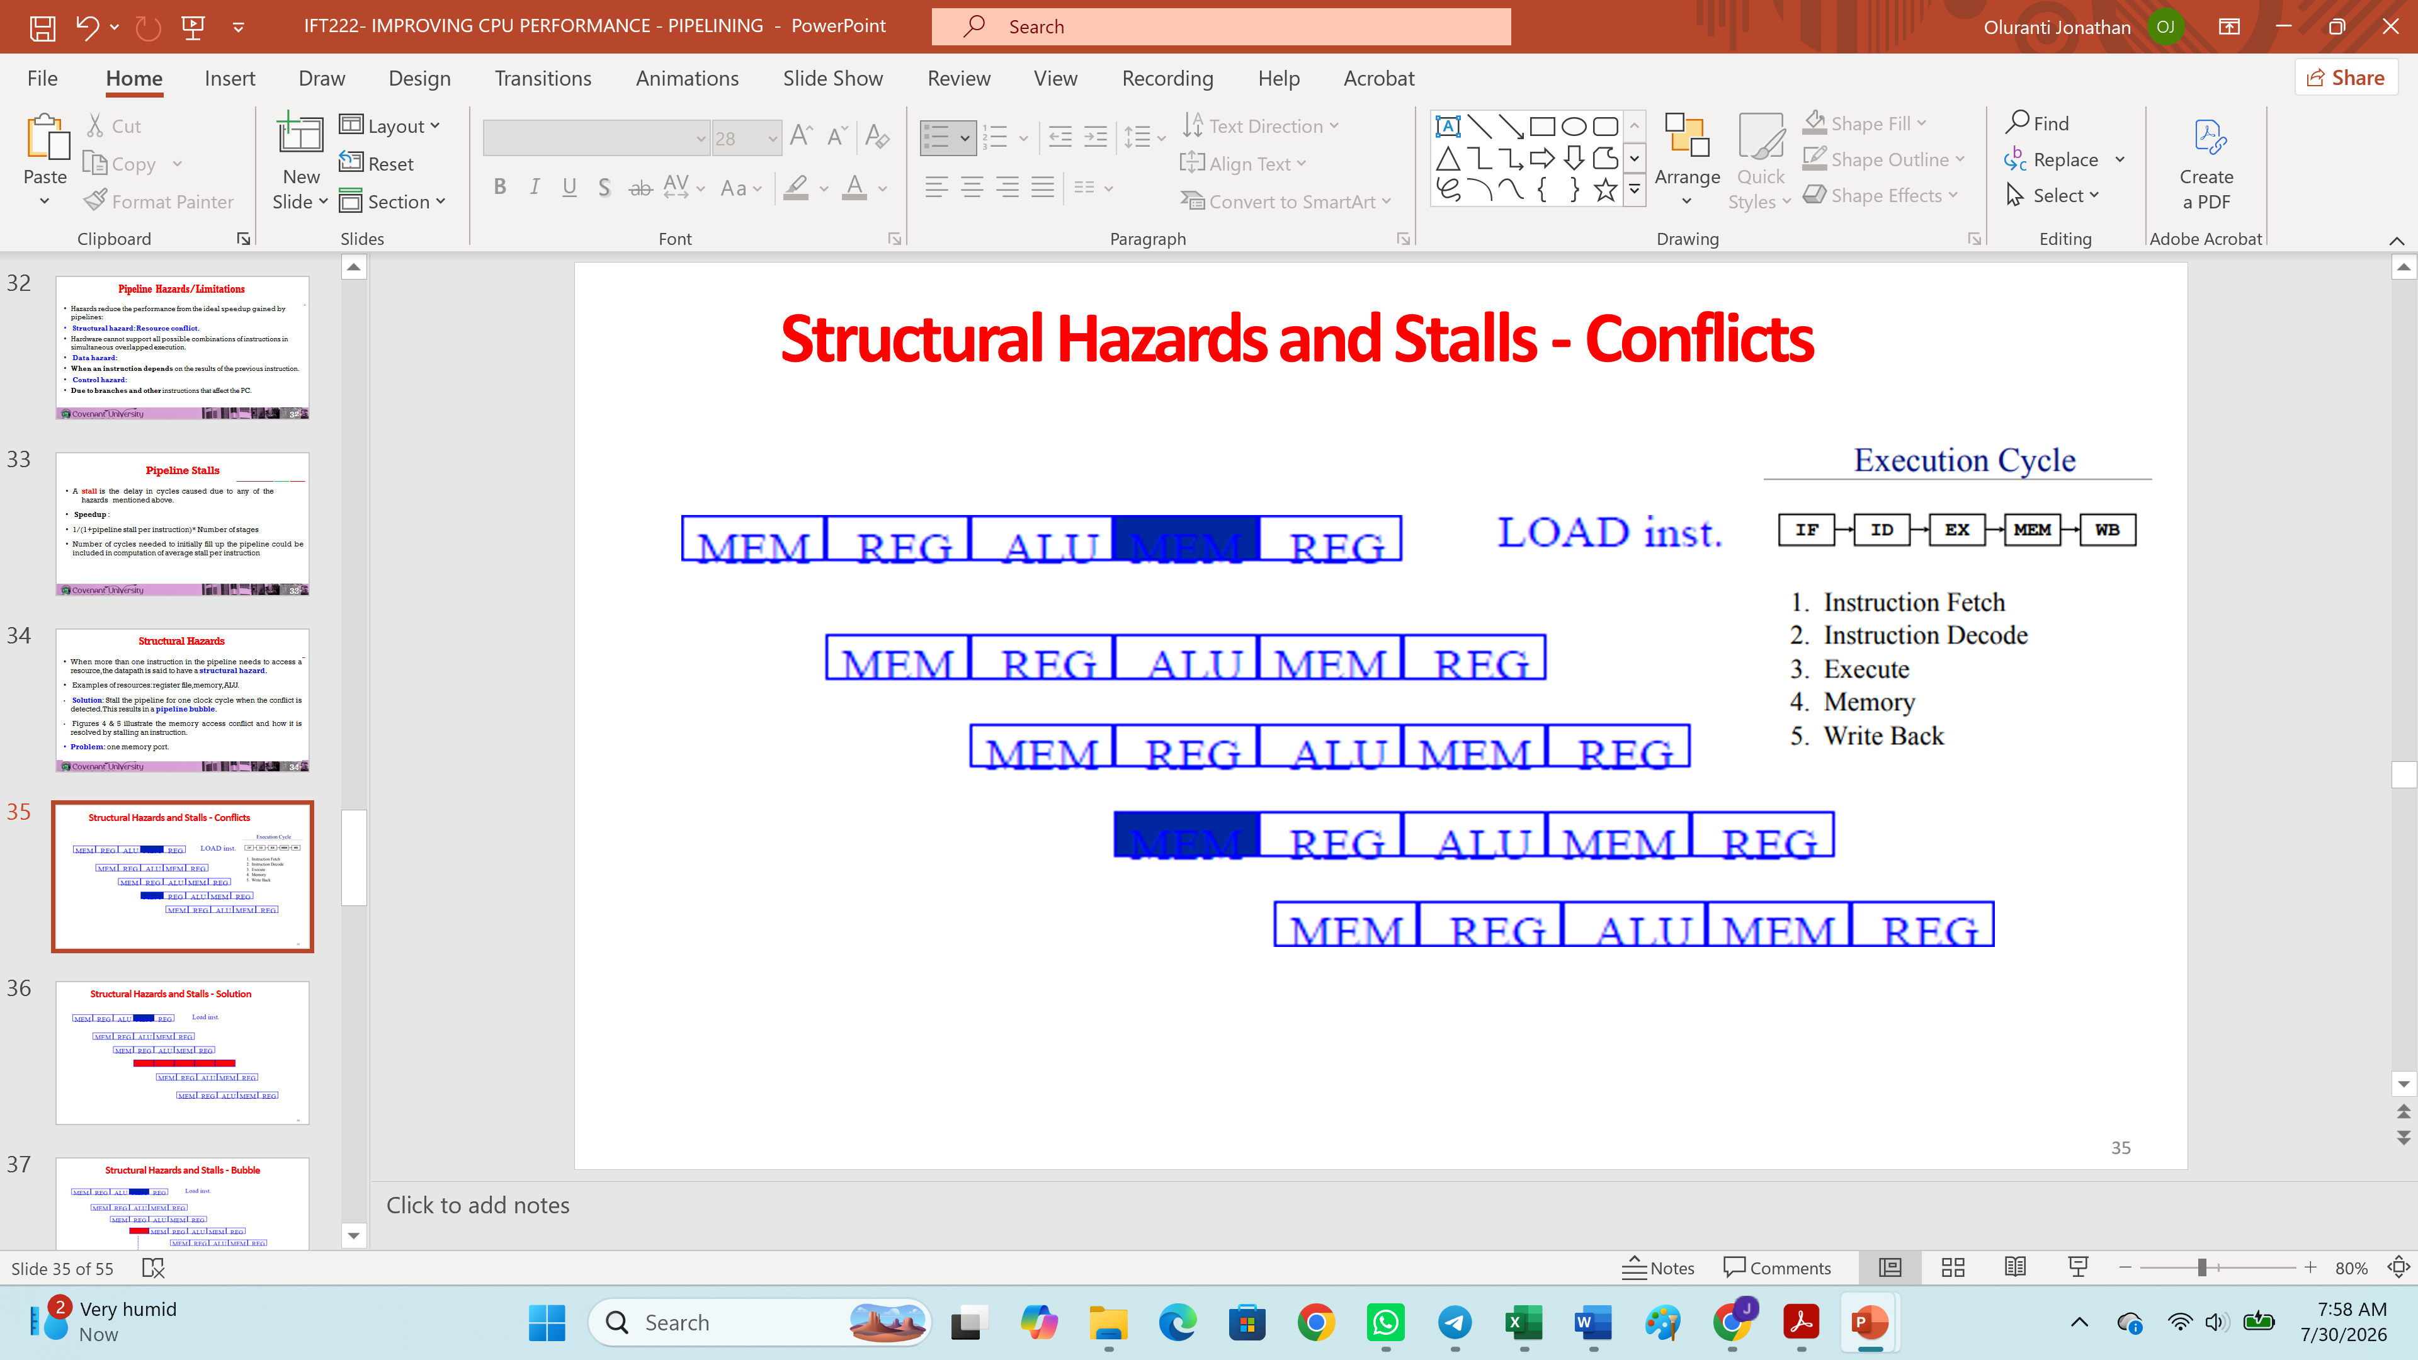
Pipelining Hazards
When more than one instruction in the pipeline needs to access a resource, the datapath is said to have a structural hazard.
Examples of resources: register file, memory, ALU.
Solution: Stall the pipeline for one clock cycle when the conflict is detected.
A stall is the delay in cycles caused due to any of the hazards mentioned above.
This results in a pipeline bubble.

Slide 34
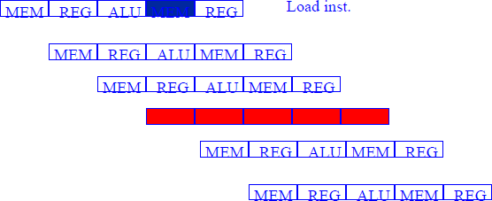
Structural Hazards and Stalls - Solution

Slide 35
Data Hazard Classification
RAW - Read After Write. Most common: solved by data forwarding.
WAW - Write After Write : Inst i (load) before inst j (add).
Both write to same register. But inst i does it before inst j. DLX avoids this by waiting for WB to write to registers. So no WAW hazard in DLX.
WAR - Write after Read: inst j tries to write a destination before it is read by I, so I incorrectly gets its value. This cannot happen in DLX since all inst read early (ID) but write late (WB).
But WAW happens in complex instruction sets that have auto- increment mode and require operands to be read late cycle experience WAW.

Slide 36
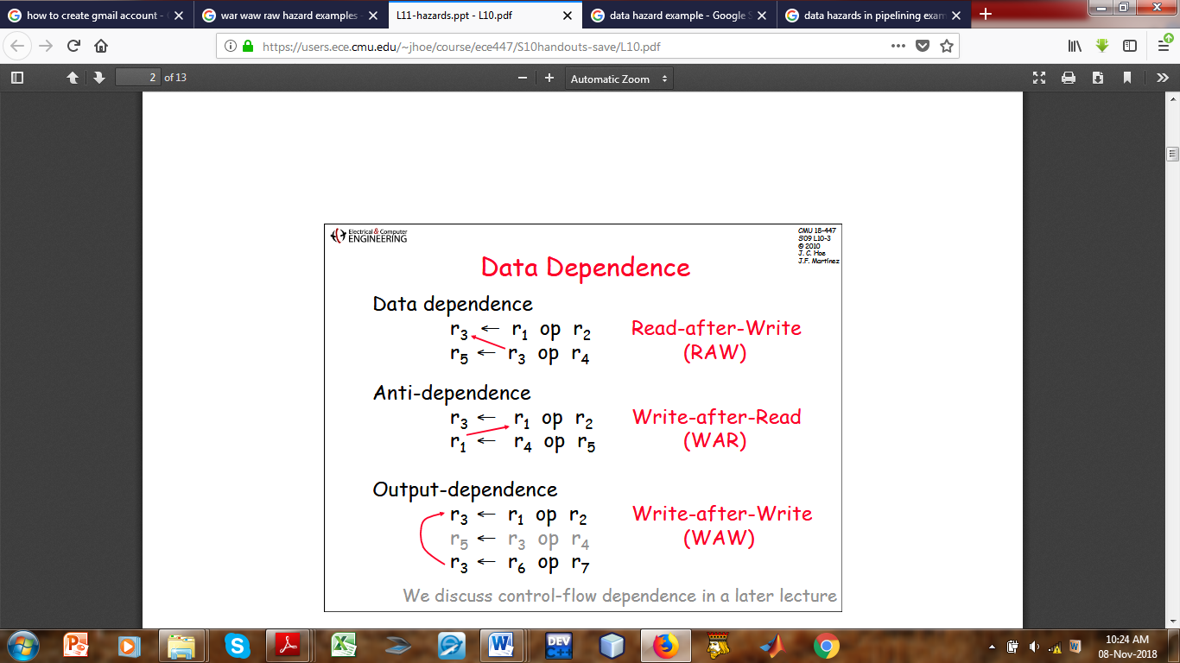
Data Hazard Classifications
  Describe each of the following categories of Data Hazards: RAW, WAR, WAW. Using (I – iii) below state which is RAW, WAR or WAW and indicate how each occurs using an arrow.
R3 ← R1 op R2 ii) R3 ← R1 op R2 iii) R3 ← R1 op R2
R5 ← R3 op R4 R1 ← R4 op R5 R3 ← R6 op R7

Slide 37
Examples on Cache Mapping Functions

Slide 38
DIRECT MAPPING FUNCTION
Formula
For Direct Mapping:
Cache Line=(Main Memory Block Number) mod (Number of Cache Address)
Format
Tag | Index | Offset​

Slide 39
DIRECT MAPPING FUNCTION
Example 1: 0000, 0001, 0010….. 1111
Given
Main Memory = 64 KB
Cache Size = 1 KB (1024 bytes = 2¹⁰ bytes = 10 bits)
Block Size/line size = 16 Bytes = 4bits
Find
Address bits of M/M
64KB = 2¹⁶ bytes (1KB = 1024 BYTES = 2¹⁰ BYTES)
2⁶ X 2¹⁰ = 2¹⁶ = LOG₂ 2¹⁶
Address bits:16

Slide 40
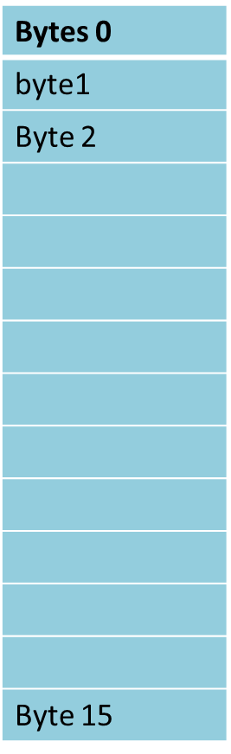
DIRECT CACHE MAPPING
Find Offset Bits:
Offset Bits
16B = 24
Offset = 4 bits (0000, 0001, 0010…., 1111)
Find number of Cache lines:
Number of Cache Lines
1024 bytes/16 bytes ​= 64 lines (of size 16bytes each)
64 = 2⁶
Index = 6 bits (number of bits used to identify each line)
(000000, 000001, 000010,……., 111111)

Slide 41
DIRECT CACHE MAPPING
Find the number of Tag Bits
tag bit = total no. of m/m bits – ( index + offset)
Tag = 16 − 6 − 4
Tag = 6 bits
Address Format for cache
Tag Index Offset
6 bits 6 bits 4 bits
from cpu 000010 000011 1001 ( 2 , 3, 9)

Slide 42
DIRECT CACHE MAPPING
5. Determine the Tag Directory Size
Tag Directory Size = Total cache lines x Tag Bits
64 × 6 = 384 bits
= 48 bytes (384/8)
Answer
Offset = 4 bits
Index = 6 bits
Tag = 6 bits
Tag Directory Size = 384 bits (48 bytes)

Slide 43
DIRECT CACHE MAPPING
Example 2
Given
Main Memory = 128 KB
Cache = 4 KB
Block = 32 B
Find:
Offset
Index
Tag bits
Tag Directory Size
Example 3
Given
Main Memory = 1 MB
Cache = 8 KB
Block = 64 B
Find:
Offset
Index
Tag bits
Tag Directory Size

Slide 44
FULLY ASSOCIATIVE CACHE MAPPING FUNCTION
What are the differences between the three cache mapping functions?
Direct = each block to exactly 1 line
Formula
Any memory block can be placed in any cache line.
Address Format
Tag | Offset ​
There is No index field

Slide 45
FULLY ASSOCIATIVE MAPPING
Find Offset bit
16B = 2⁴
Offset = 4 bits
Tag
16−4 = 12 bits
Cache Lines
1024/16​ = 64 lines
Tag Directory
64 × 12 = 768 bits
= 96 bytes
Example 1
Given
Main Memory = 64 KB
Cache size = 1 KB
Block size/line size = 16 B
Address Bits
64KB = 2¹⁶
Address = 16 bits

Slide 46
FULLY ASSOCIATIVE MAPPING
Example 2
Given
Main Memory = 256 KB
Cache = 4 KB
Block = 32 B
Find
Offset bits
Tag bits
Total Cache lines
Tag Directory Size
Example 3
Given
Main Memory = 2 MB
Cache = 16 KB
Block = 64 B
Find
Offset bits
Tag bits
Total Cache lines
Tag Directory Size

Slide 47
SET ASSOCIATIVE MAPPING
Formula
For an n-way set associative cache: (8-way set associative)
Number of Sets = Cache Lines / n
Address Format
Tag | Set Index | Offset
​

Slide 48
SET ASSOCIATIVE MAPPING
Address Bits
64KB = 2⁶ X 2¹⁰ = 16
Offset
16B = 2⁴
Offset = 4 bits
Cache Lines
1024/16 = 64
Sets
64/2 = 32
Set Index = 5 bits
Example 1 (2-Way Set Associative)
Given
Main Memory = 64 KB
Cache = 1 KB
Block size = 16 B
2-Way Set Associative
Tag Bit = 16 – 5 – 4 = 7 bits
Tag Directory = 7 x 64 = 448 bits
= 56bytes

Slide 49
SET ASSOCIATIVE MAPPING
Example 2 (4-Way Set Associative)
Given
Main Memory = 512 KB
Cache = 8 KB
Block = 32 B
4-Way
Find
Address bits
Offset
Cache lines
Set bit
Tag bits
Tag directory size
Example 3 (8-Way Set Associative)
Given
Main Memory = 4 MB
Cache = 32 KB
Block = 64 B
8-Way
Find
Address bits
Offset
Cache lines
Set bit
Tag bits
Tag directory size

Slide 50
READ THE SLIDES ON
RISC VS CISC ARCHITECTURES
AND EVERY OTHER SLIDES PROVIDED

Slide 51
ENSURE YOU PREPARE FOR THE EXAMINATION

